Slide 1



Website for ARVIND SNACKS
PROJECT MEMBERS
ASWIN S (19ITR014)
JAIHARI D (19ITR028)
KARAMCHAND SUBASH K (19ITR034)
PROJECT GUIDE
Dr. J.PREMALATHA
Professor/Department of IT
Kongu Engineering College

Slide 2
KEC-IT
Company Details
Company name:
Arvind Snacks
Address:
Arvind Chettinad Snacks ,
Shed No.38,
Sidco Kappalur,
Madurai – 625 0008.
Contact:
Mobile: +91 98432-26920
+91 94430-26920
2

Slide 3
Project Details
Develop a Website
Ease the communication between the factory and shop

Slide 4
KEC-IT
Objective(s)
Design and develop an website for Arvind Snacks and to maintain product stock details
UI with maximum functions
4

Slide 5
KEC-IT
Module Description
Login module:
New users can register
Both users and admin can login using their credentials
Factory module:
Add , delete , updates details
Receive order and manage orders
Shop module:
Notify every ordered catalogue’s that need to be dispatched
Product insertion and deletion that added to cart done by branch managers.
5

Slide 6
KEC-IT
Hardware & Software requirements
Hardware : 4GB RAM , i3 processor
Front End:
HTML – HTML for page layout
CSS – CSS UI design for page layout
JAVASCRIPT – for action listener
Back End:
Node.js,express.js– For backend logic
Mongodb – For product details and description
Tools:
ejs(Embedded Javascript)-For dynamic page
6

Slide 7
KEC-IT
References
HTML , CSS - W3schools
JAVASCRIPT – Javascript for Dummies Book
7

Slide 8
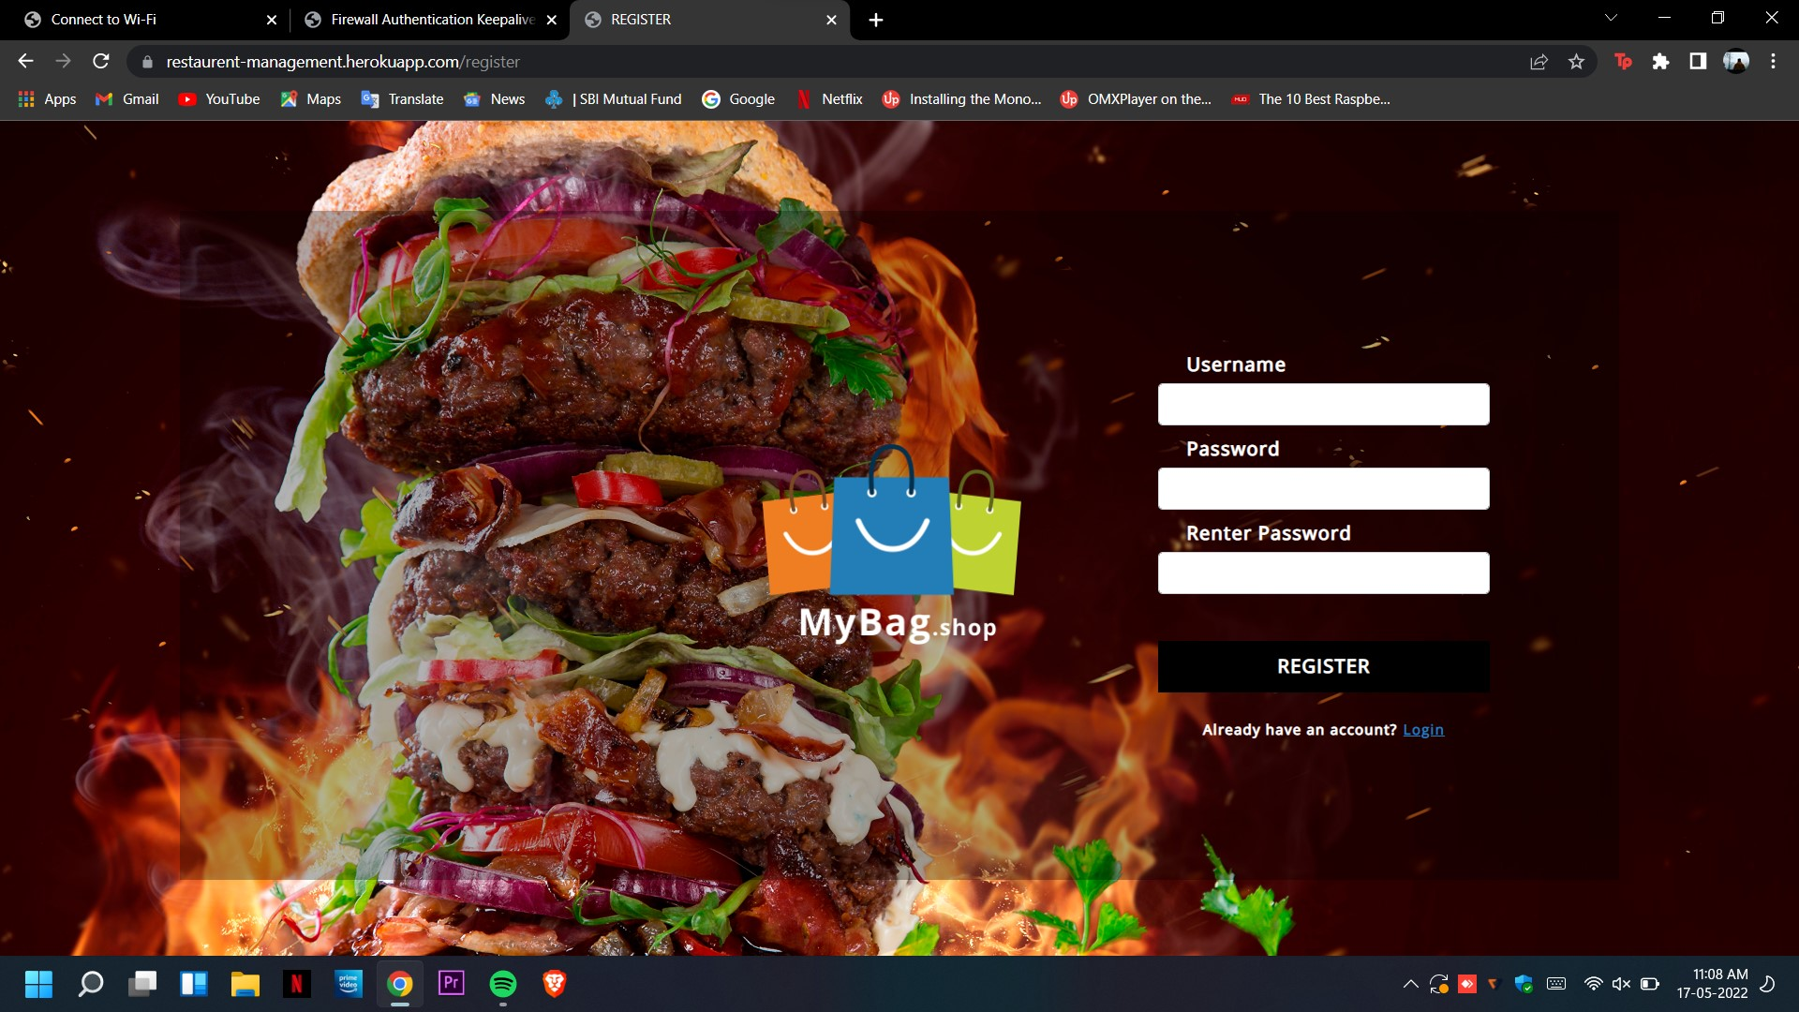
Modules Completed - LOGIN MODULE(registration)

Slide 9
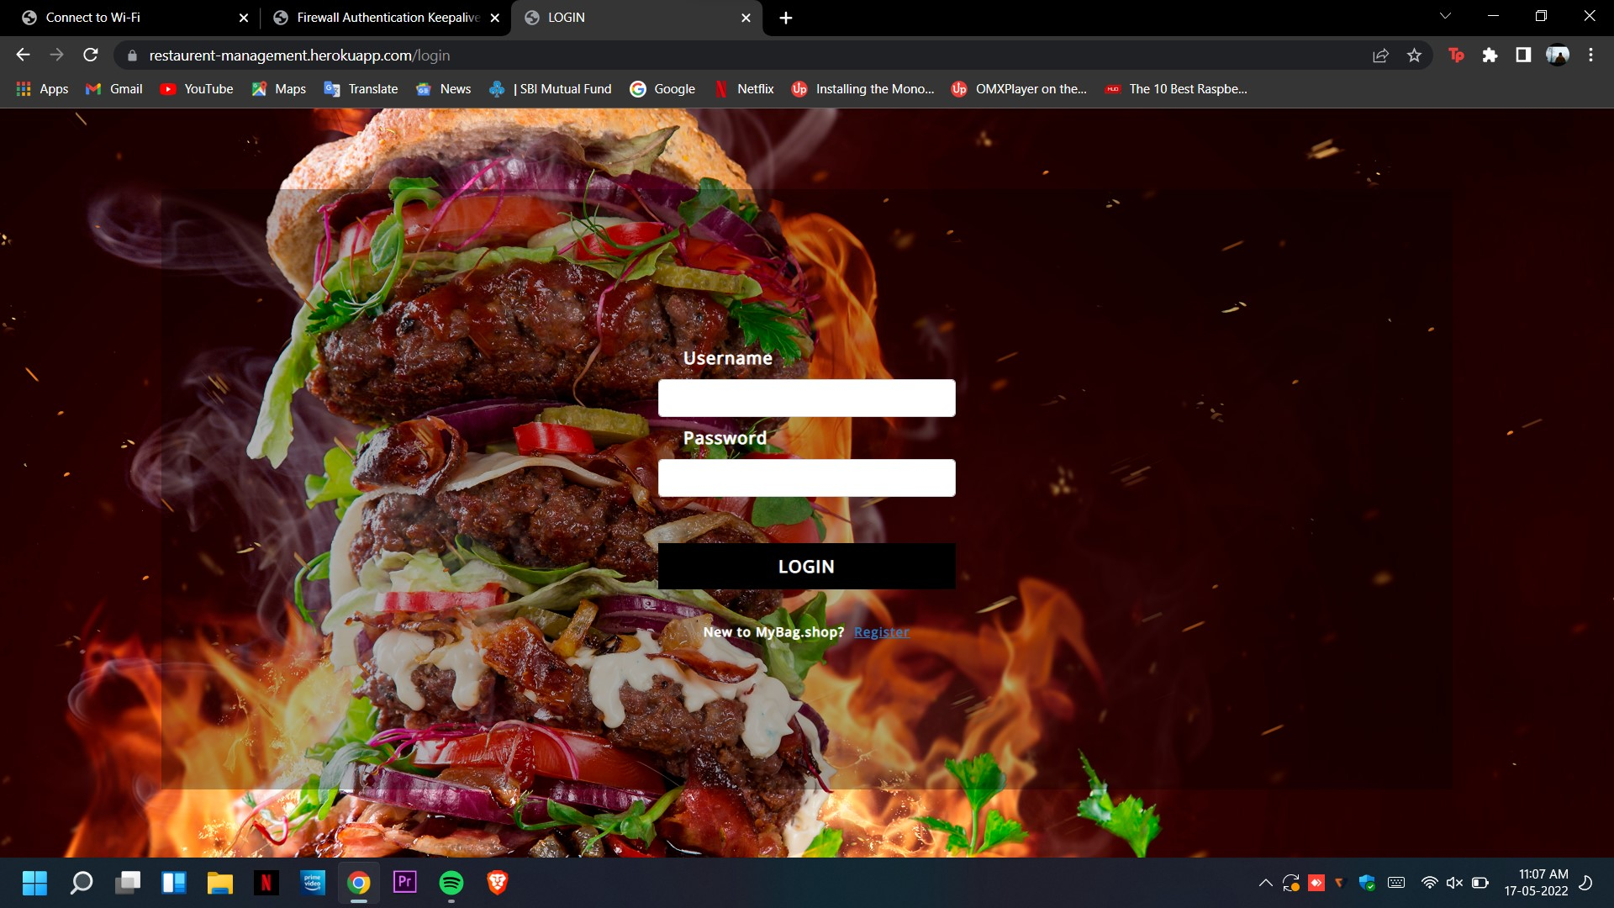
Modules Completed - LOGIN MODULE

Slide 10
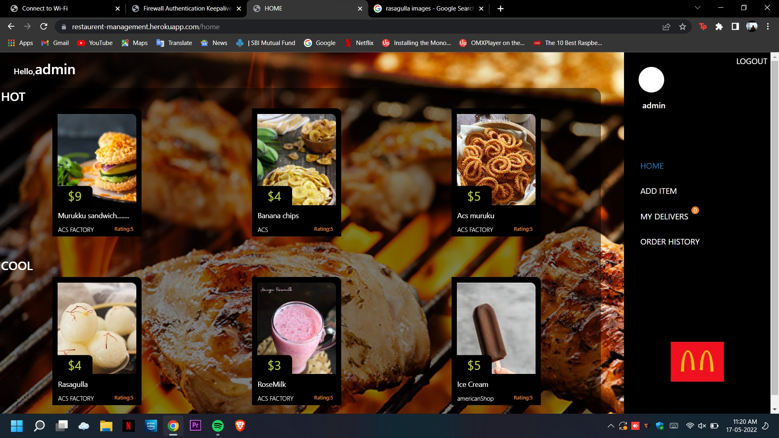
Factory module/admin – Admin dashboard

Slide 11
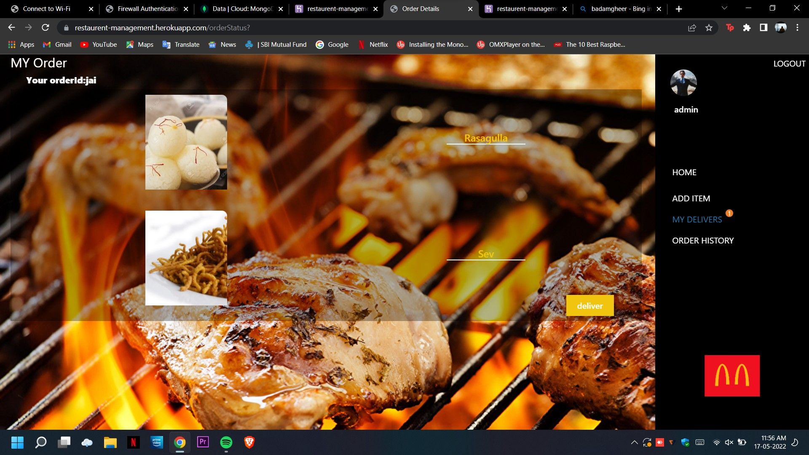
Factory module/admin – Admin view the orders from shop

Slide 12
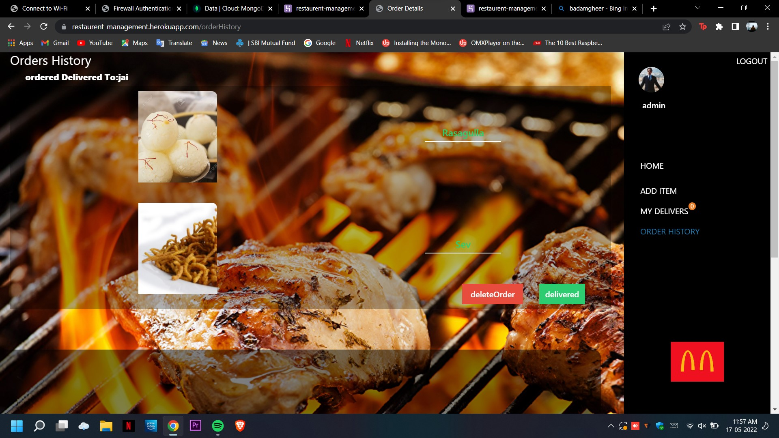
Factory module/admin – Delivered History

Slide 13
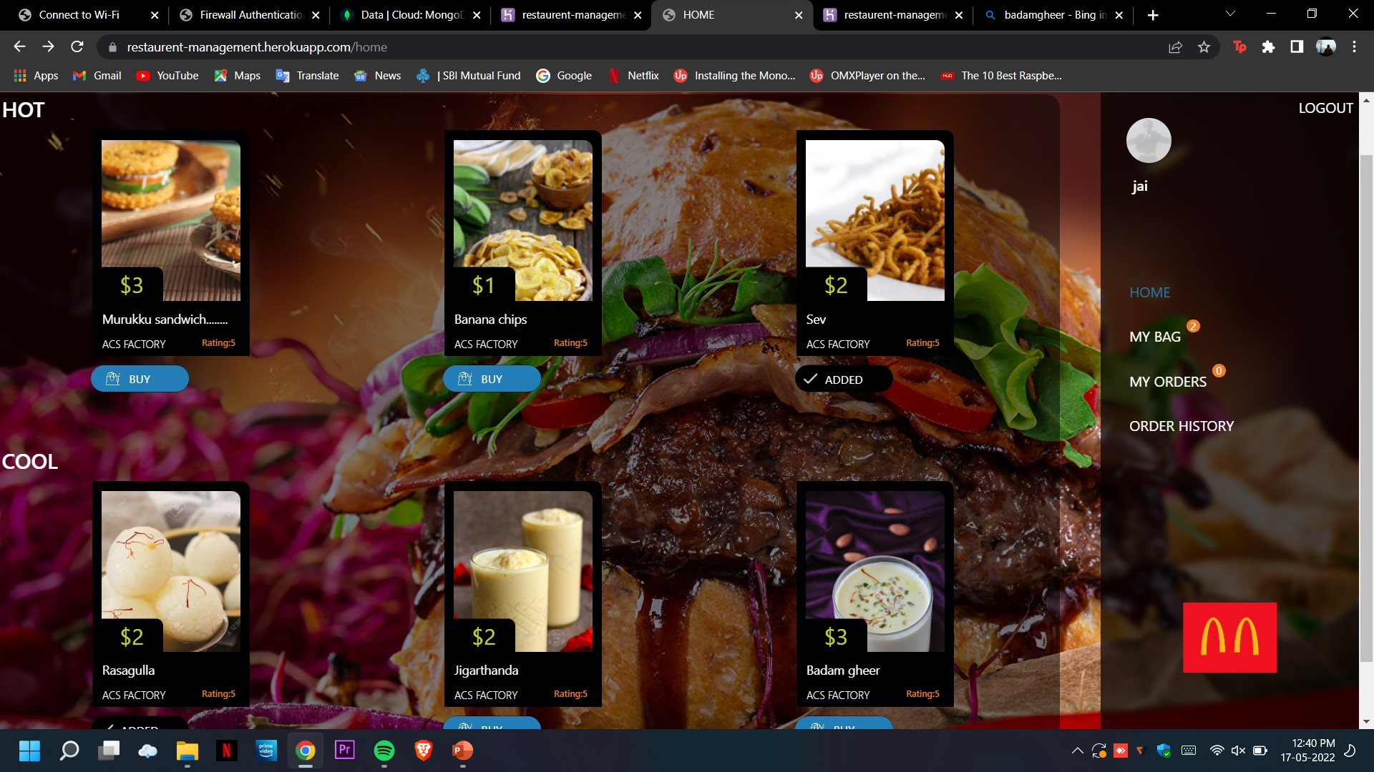
Shop’s/User’s Module – User view the items available

Slide 14
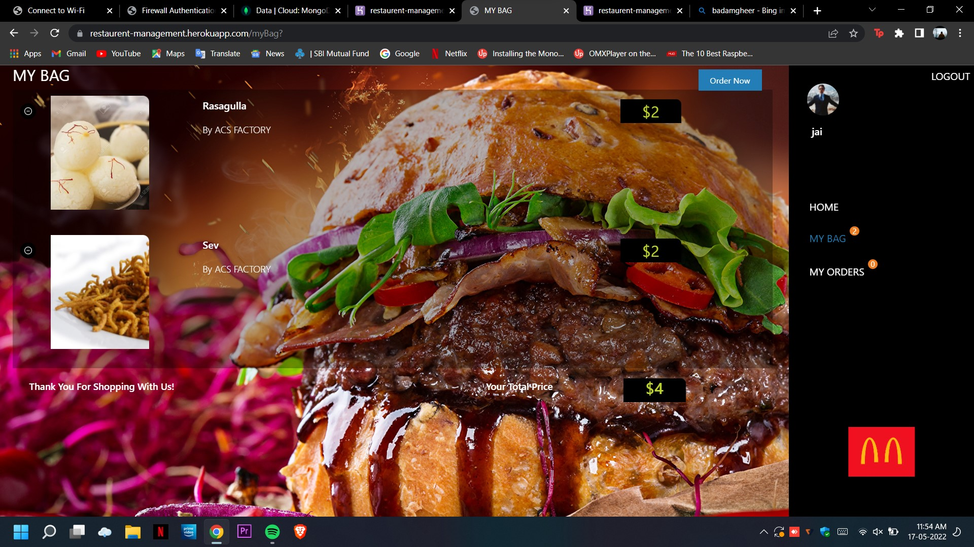
Shop’s/User’s Module – User add the items in cart

Slide 15
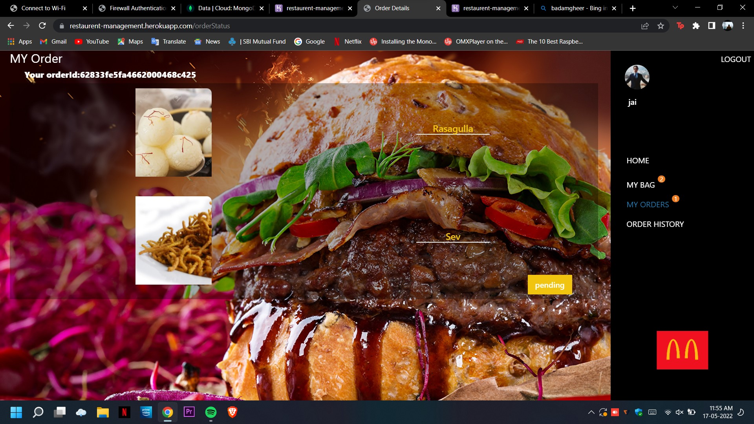
Shop’s/User’s Module – Delivery Pending

Slide 16
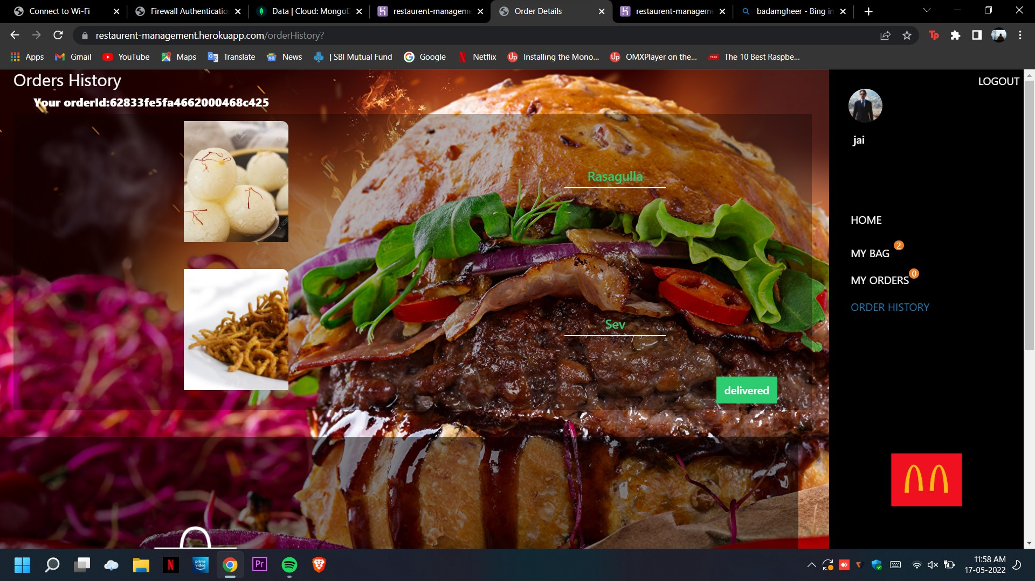
Shop’s/User’s Module – Users’s Order history

